Slide 1

IE 212: Computational Methods for Industrial Engineering
Lecture Notes #3:
Manipulating Excel Objects
Dr. J. David Porter
Winter 2013

Slide 2
Objects, Properties, and Methods
In this module, various properties and methods for commonly manipulated objects will be demonstrated
  Ranges
  Workbooks
  Worksheets
The following aspects of programming in VBA will also be discussed
  The With…End construct
  Cell naming and referencing
  Excel formulas and functions

Slide 3
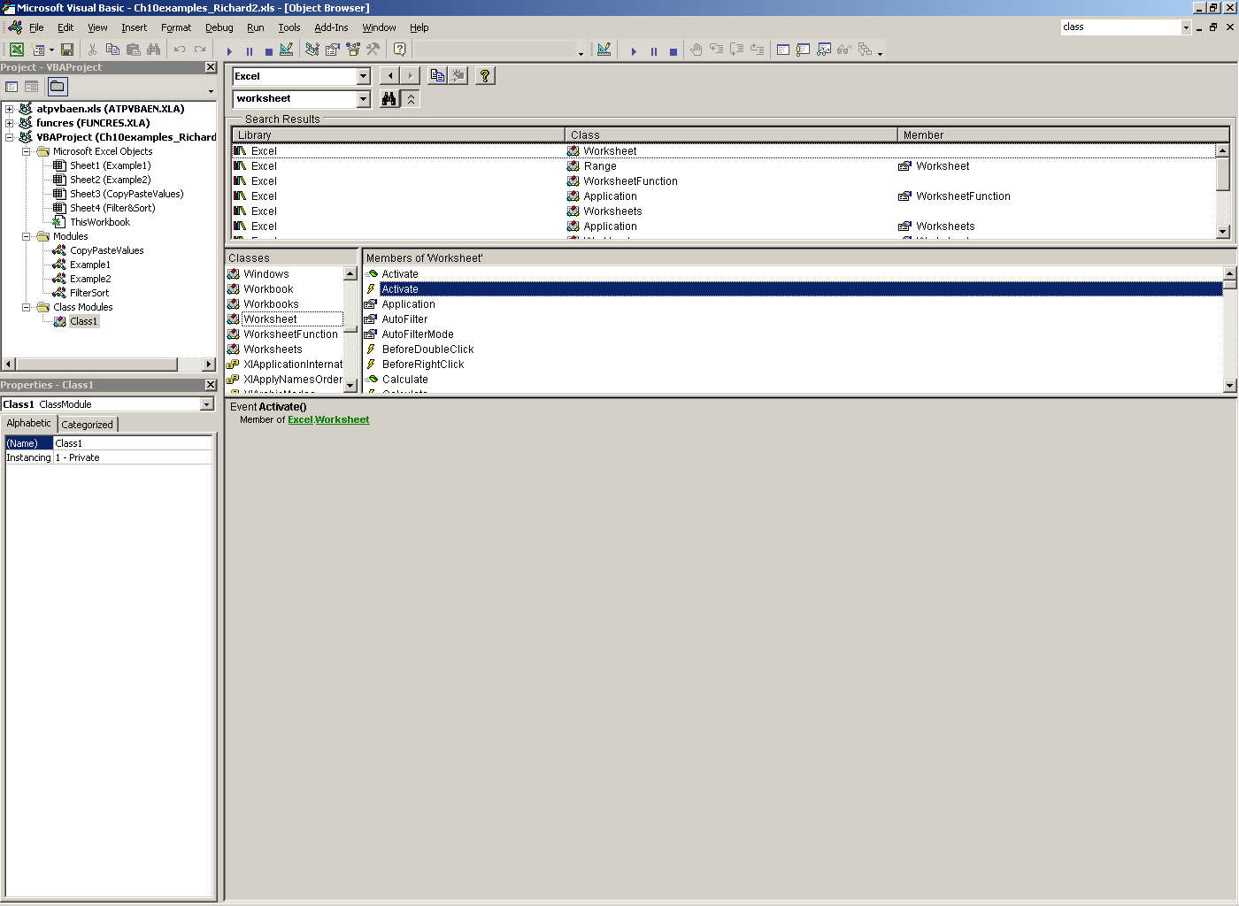
Objects, Properties, and Methods (cont.)
VBA code can be used to manipulate Excel objects to more advanced degree than using just Excel functionality
Knowing how to find object properties and methods with the Object Browser and VBE tools is fundamental

Slide 4
The Range Object
The Range object is arguably the most used object in Excel VBA
  A Range object can be a single cell, a rectangular block of cells, or the union of many rectangular blocks (i.e., a non-continuous range)
The Range object has several properties and methods, e.g.,
  Properties
    Color
    Border
    Values
    Font
  Methods
    Clearing
    Copy
    PasteSpecial

Slide 5
Range – Color Format
The Interior property is used to change the color of the cell(s) within a range
There are a few sub properties that can be used
  ColorIndex
  Color
  Pattern
Notes:
For a list of color indices search for PatternColorIndex in VBA Help
For a list of common VB Constants for colors search for Color Constants in VBA Help
For a list of common RGB values search for RGB Function in VBA Help

Slide 6
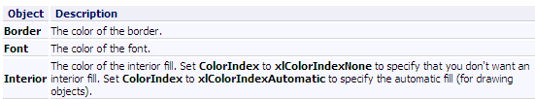
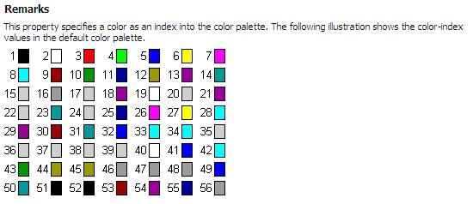
Range – Color Format (cont.)
ColorIndex property
  Value = numerical color index
Notes:
For a list of color indices search for PatternColorIndex in VBA Help
For a list of common VB Constants for colors search for Color Constants in VBA Help
For a list of common RGB values search for RGB Function in VBA Help

Slide 7
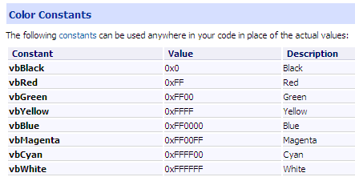
Range – Color Format (cont.)
Color property
  Value = VB Constant or RGB Function
Notes:
For a list of color indices search for PatternColorIndex in VBA Help
For a list of common VB Constants for colors search for Color Constants in VBA Help
For a list of common RGB values search for RGB Function in VBA Help

Slide 8
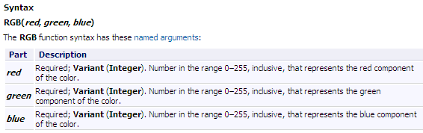
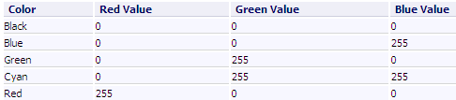
Range – Color Format (cont.)
Color property
  Value = VB Constant or RGB Function
Notes:
For a list of color indices search for PatternColorIndex in VBA Help
For a list of common VB Constants for colors search for Color Constants in VBA Help
For a list of common RGB values search for RGB Function in VBA Help

Slide 9
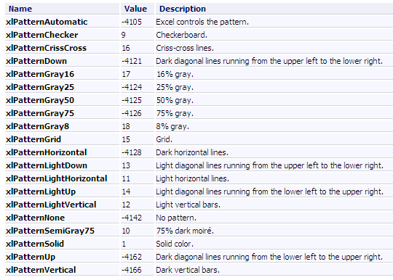
Range – Color Format (cont.)
Pattern property
  Value = XL Constant
Notes:
For a list of color indices search for PatternColorIndex in VBA Help
For a list of common VB Constants for colors search for Color Constants in VBA Help
For a list of common RGB values search for RGB Function in VBA Help

Slide 10
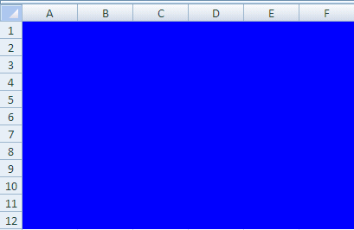
Range – Color Format (cont.)
In-Class Exercise
  Open a new workbook in Excel
  Name this file “Objects.xlsm”
  Change the range “A1:F12” in Sheet1 so that the interior color is BLUE, as shown in the figure below
    Use all the properties just explained
  Also experiment with the property Pattern
    Apply xlPatternGray50 and xlPatternSolid to the same cell range
Sub ColorBlue()
Range("A1:F12").Select
'Change color with ColorIndex property
Range("A1:F12").Interior.ColorIndex = 5
'Change interior color with Color property
'Using VB constants
Range("A1:F12").Interior.Color = vbBlue
'Using RGB function
Range("A1:F12").Interior.Color = RGB(0, 0, 255)
End Sub
Notes:
Note that we should always activate the Worksheet which we want the macro to affect
Quick Programming Note: To ignore a line of code while experimenting with programming or debugging, you can type a ‘ mark. This will turn your code a green color in the VBE denoting that it should not be read when the code is run. This is also the method with which you can enter comments into your code. For example, you may want to explain what the sub procedure does to another user who may use your code. You could simply type the ‘ mark followed by a brief text description of your code.
Remember, you can always record a macro first if you are unsure of what property/method to use

Slide 11
Range – Border Format
There is one main property and one main method to format the border of a range
The Borders property has several sub properties
  LineStyle
    Value = xlDashed, xlSolid, …
  Weight
    Value = xlThick, xlThin, …
  Color
    Value = VB Constant, RGB Function
  XL Constants
    xlInsideHorizontal, xlEdgeBottom, …

Slide 12
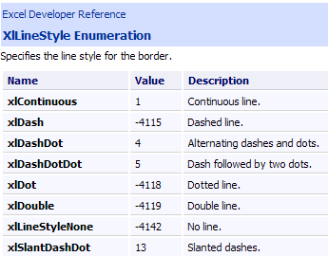
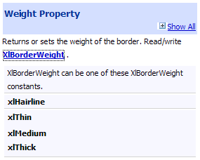
Range – Border Format (cont.)
Values for sub properties LineStyle and Weight

Slide 13
Range – Border Format (cont.)
The BorderAround method has several possible arguments
  LineSytle:= xlDash, xlSolid, …
  Weight:= xlThick, xlThin, …
  Color:= VB Constant, RGB Function
Notice that a combination of a colon and an equal sign are used to define the argument of the method (:=)
  This is different than the values of properties that are set using just an equal sign (= )
Range("A1:F12").BorderAround
LineStyle:=xlContinuous, Weight:=xlThick, Color:=vbBlack

Slide 14
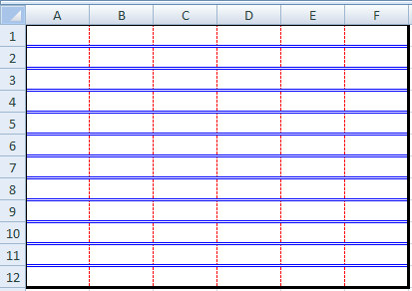
Range – Border Format (cont.)
In-Class Exercise
  Use the Excel file “Objects.xlsm” created previously
  Change the borders of the range “A1:F12” in Sheet2 so that it looks like the figure shown below
    Use both the Borders property and the BorderAround method

Slide 15
Range – Values
The Value property is used in VBA to assign values to ranges
The value of a cell or a group of cells can be
  Text
  Numerical
  Formula
  Reference
  Variable

Slide 16
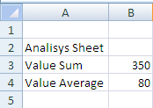
Range – Values (cont.)
In-Class Exercise
  Write VBA code to enter several different values into Sheet3, as shown below
    Add Sheet3 to your workbook, if necessary

Slide 17
Range – Font Format
The Font property is used in Excel VBA to format fonts of ranges
There are several sub properties to use with the Font property
  Bold
    Value = True or False
  Size
    Value = number
  Color
    Value = VB Constant, RGB Function
  ColorIndex
    Value = number
  FontStyle
    Value = “style”

Slide 18
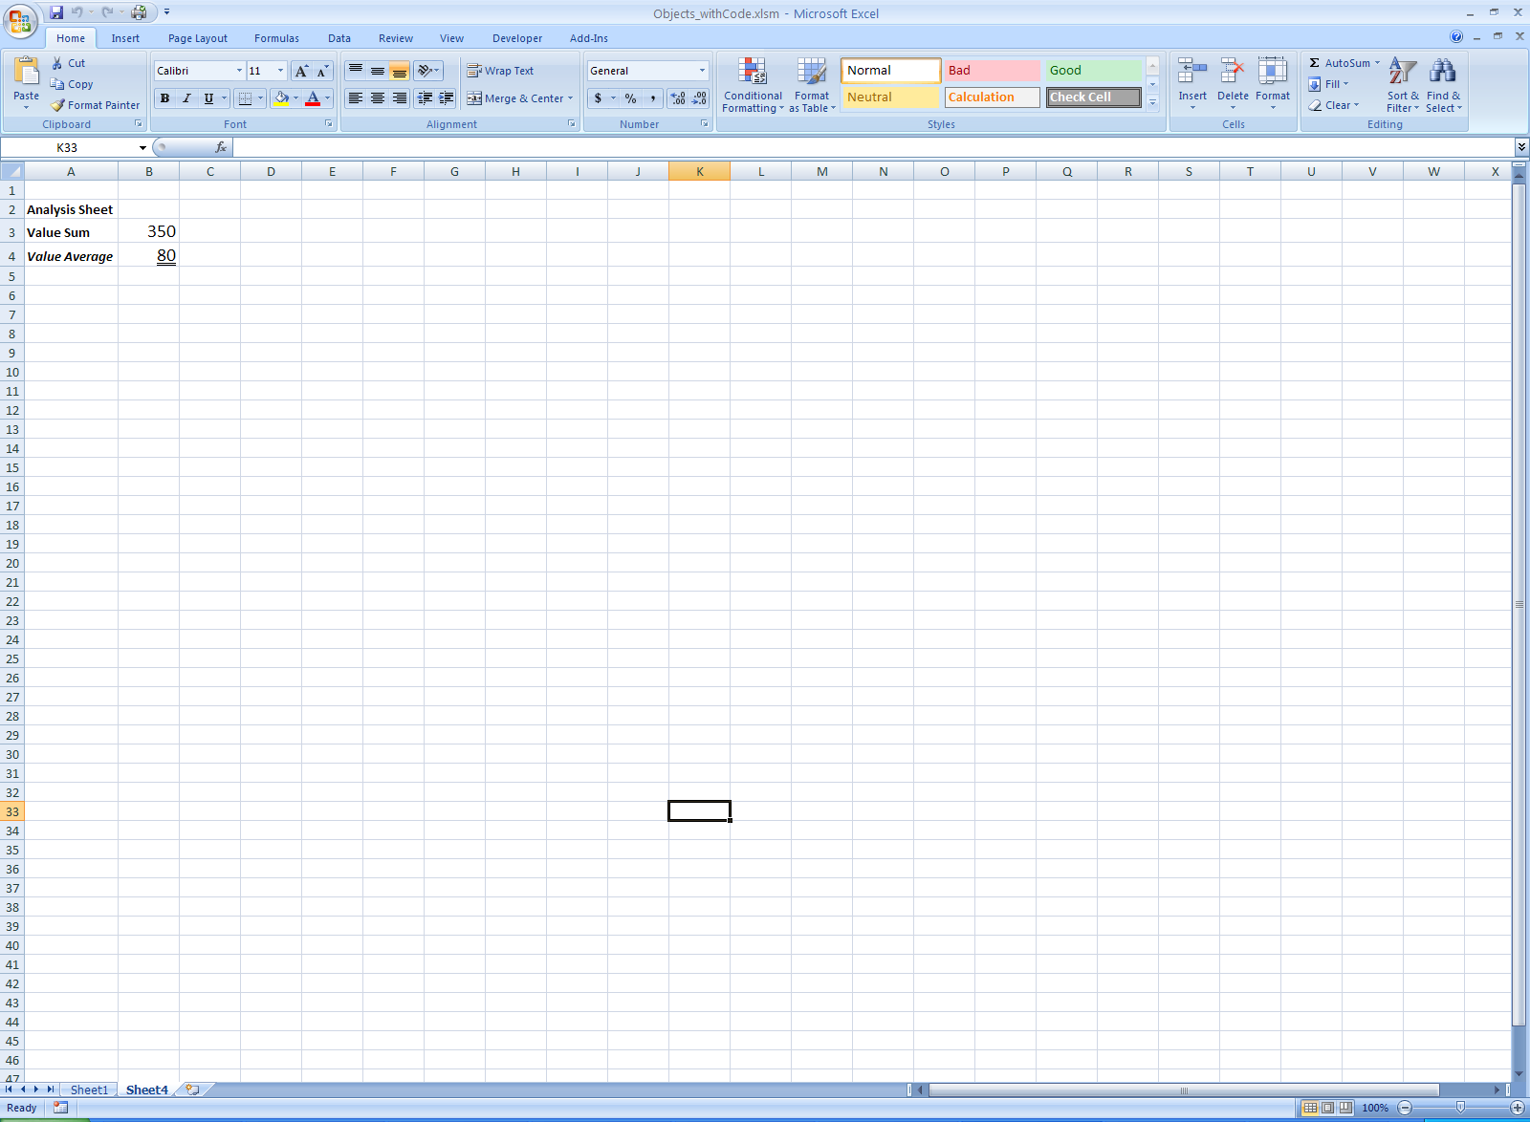
Range – Font Format (cont.)
In-Class Exercise
  Write VBA code to format the font of the values you entered in Sheet3 so that the look as shown in the figure below

Slide 19
Range – Clearing Contents
There are three methods commonly used to clear a range of cells
  Clear
    Clears everything
  ClearContents
    Only clears values or formulas
  ClearFormats
    Only clears formats
It is important to know which method is most appropriate for your worksheet
Notes:
Also very important to activate the appropriate worksheet before clearing anyting
Following example shows that using the wrong method can reset formatting that you will have to format again which can be inefficient

Slide 20
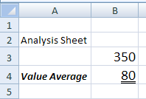
Range – Clearing Contents (cont.)
In Class Exercise
  Write VBA code to produce the effects shown below in Sheet3

Slide 21
Range – Conditional Formatting
Also associated with formatting the Range object is the FormatConditions object, which places conditional formatting on a specified range of cells
There are three main methods and several properties for this object
  Add
  Modify
  Delete

Slide 22
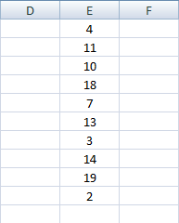
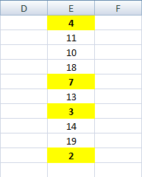
Range – Conditional Formatting (cont.)
In Class Exercise
  Add another sheet to the file “Objects.xlsm” (Sheet4) and enter the values shown below in the table labeled “Original data”
  Write VBA code to place a conditional format on the range of cells so that any cell with a value less than 10 has a yellow fill and bold font
Original data
Result

Slide 23
The Application Object
The Application object is useful when executing VBA code that copies and pastes large amounts of data
This object has two main properties
  ScreenUpdating
    Value = True or False
  CutCopyMode
    Value = True or False
There is also one main method
  Wait
    Arguments = Now, TimeValue

Slide 24
The Application Object (cont.)
The ScreenUpdating property
  Helps the VBA code run more efficiently since the Excel screen does not need to be updated after every action in the code
    Eliminates the flickering of the screen
The CutCopyMode property
  Prevents a flashing box from remaining around the range which has been copied after a macro has been executed

Slide 25
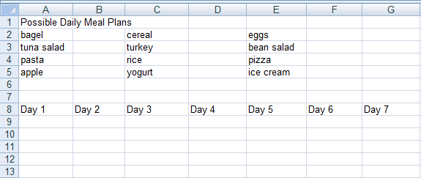
The Application Object (cont.)
In Class Exercise
  Insert a new worksheet into workbook “Objects.xlsm”
    This will be Sheet5
Enter the values shown below
Write VBA code to understand the effect of the properties CutCopyMode and ScreenUpdating

Slide 26
The Wait Method
The Wait method is used frequently when Excel is used to perform simulations
Wait pauses the macro while it is being run until a specified time is reached
  The Now argument
    Calculates the current time
  The TimeValue argument
    Gives an integer-valued time amount to add to the current time
The macro will play again once Now plus TimeValue time is reached

Slide 27
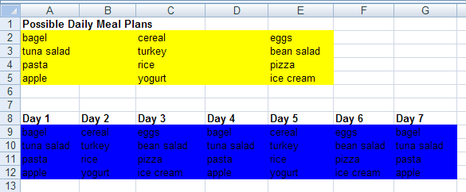
The Wait Method (cont.)
In Class Exercise
  Use the Wait method to obtain the results shown below in Sheet5

Slide 28
The With Construct
The With construct is used to set several properties of one object in an enclosed statement
For example, compare these two sets of code
Range(“A1:C8”).Interior.Color = vbRed
Range(“A1:C8”).Font.Bold = True
Range(“A1:C8”).Font.Name = “Arial”
Range(“A1:C8”).Borders(xlEdgeBottom).LineStyle = xlDash
With Range(“A1:C8”)
.Interior.Color = vbRed
.Font.Bold = True
.Font.Name = “Arial”
.Borders(xlEdgeBottom).
LineStyle = xlDash
End With
Notes:
More programming structures are discussed in Ch 15

Slide 29
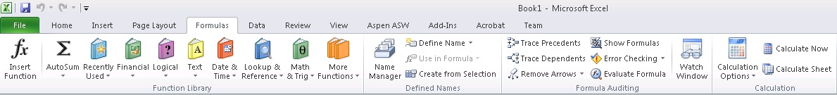
Naming Ranges
The most common way to assign object names is by using the Name property
When you name a cell in Excel using Formulas > Define Name > Define Name…, the name appears in the name window whenever the corresponding range is selected
  The same occurs after naming a range in VBA

Slide 30
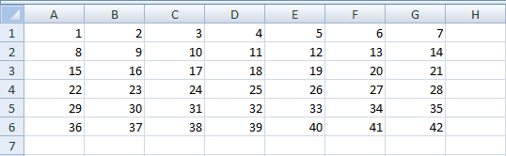
Naming Ranges (cont.)
In Class Exercise
  Insert a new worksheet into workbook “Objects.xlsm”
    This will be Sheet6
Enter the values shown below
Notes:
It is more efficient to name ranges in Excel rather than in VBA

Slide 31
Referencing Ranges in VBA
There are several ways to reference ranges and cells using VBA
  Offset
  Cells
  Rows
  Columns
  EntireRow
  EntireColumn
  End

Slide 32
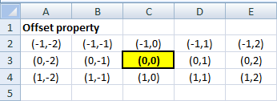
Offset vs. Cells
The Offset property
  Considers the upper left-most cell in the range (could be a named range) to be in the 0th row and 0th column
  It offsets the range selection downward by a certain row count (if positive) or upward (if negative) of the range
  It offsets the range selection to the right by a certain column count (if positive) or to the left (if negative) of the range

Slide 33
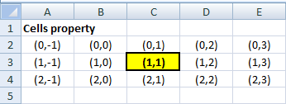
Offset vs. Cells (cont.)
The Cells property
  Considers the upper left-most cell in the range (could be a named range) to be in the 1st row and 1st column
  It then finds the cell in the x^{th} row position below (if the position change is positive) or above (if the position change is negative) and the y^{th} column position to the right (if the position change is positive) or left (if the position change is negative) of the range

Slide 34
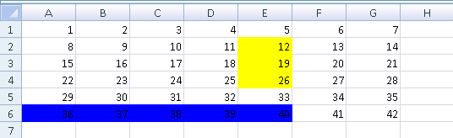
Offset vs. Cells (cont.)
In Class Exercise
  Use the Offset and Cells properties to achieve the results shown below in Sheet6
Notes:
It is more efficient to name ranges in Excel rather than in VBA

Slide 35
Columns and Rows
Columns and Rows, reference columns and rows in a named range, respectively
  Both properties take a numerical index value to find the numbered column within the named range
  Both properties consider the first column or row in the range to be indexed as 1

Slide 36
EntireColumn and EntireRow
EntireColumn and EntireRow, are used to modify every column or row in the range for the length of the column or row of the entire worksheet
The EntireColumn property will affect every column in the range and the EntireRow property will affect every row in the range for their entire respective length

Slide 37
End
End is a very useful property as it can help you find the end of a row or a column of any range of data
The End property can take four values
  For columns
    xlDown and xlUp
  For rows
    xlToRight and xlToLeft
You do not need to name an entire data range to use this property, just one cell in the data range is fine

Slide 38
Formulas with the Range Object
Two main properties can be used with the Range object
  Formula
    Value = reference by column letter and row number
  FormulaR1C1
    Value = reference by R1C1 Notation
A cell or an entire range of cells can be used with these properties
There is also one method we can use with the Range object concerning formulas
  AutoFill
    Arguments = Destination, Type

Slide 39
Formulas with the Range Object (cont.)
In Class Exercise
  We will calculate some sums and averages using the data entered in Sheet6
  We also use the AutoFill method to copy and paste formulas

Slide 40
Formulas with the Application Object
The Application object uses the WorksheetFunction property to set a function for a cell or range of cells
The WorksheetFunction property has several sub properties for almost all of the Excel functions
  Max
  Min
  Average
  Sum
  Count
  VLookup

Slide 41
Formulas with the Range Object (cont.)
In Class Exercise
  We will use the WorksheetFunction property to perform calculations using the data entered in Sheet6

Slide 42
Workbooks and Worksheets
Workbooks and Worksheets objects will not be manipulated as often as Range objects
However, there is one important method that both Workbooks and Worksheets use
  Activate
    Argument = (none)
There is one important property that Worksheets often use
  Visible
    Value = True or False

Slide 43
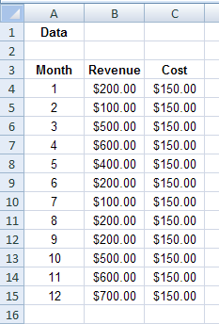
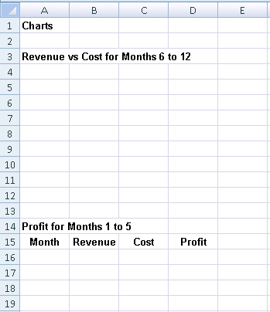
Workbooks and Worksheets (cont.)
Activate method
  We want to take some values from workbook Workbook1 and transfer them for analysis into workbook Workbook2
Workbook1
Workbook2

Slide 44
Workbooks and Worksheets (cont.)
Activate method
  We need to write VBA code in a module in workbook Workbook2
    Open both workbooks in Excel
    Create a module in Workbook2
  The code added to the module needs to do the following
    Activate workbook Workbook1
    Use the Copy method of the Range object to copy the data
    Activate workbook Workbook2
    Paste the data

Slide 45
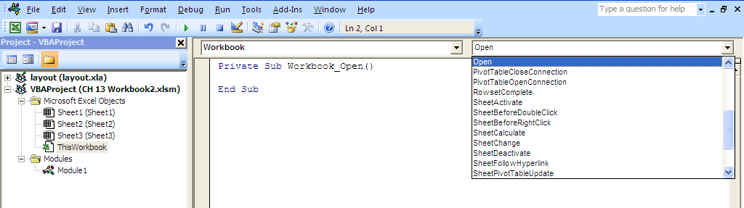
Workbooks and Worksheets (cont.)
Visible property
  We will use this property of the Worksheets objects to hide and show worksheets as we navigate the user through our Excel-based applications
  The code to accomplish this effect should be written in a sub procedure associated with the Open event of the Workbook object

Slide 46
Workbooks and Worksheets (cont.)
In-Class Exercise
  Use the Excel file “Objects.xlsm” created previously
  Go to the VBE editor
    Inside the Project Explorer window, locate the object ThisWorkbook
    Double click on the object
  Write code in the Open event so that Sheet2 and Sheet3 are hidden the next time the workbook is opened
  Save and close your workbook
  Re-open the workbook and see the resulting effect

Slide 47
Summary
Several methods and properties were covered for the following objects
  Workbooks and Worksheets
  Ranges
  Application
There are several properties of the Range object to reference ranges and cells
The With construct can help reduce code when modifying several properties of one object
Formulas can be created in VBA by using properties of the Range object and the Application object

